Slide 1
CDR Update
Spring 2016 NDEP
Area Meetings

Slide 2
Registry Statistics
Entry-Level Dietetics Practice Audit
Updated Entry-Level Dietitian and Dietetic Technician Test Content Outline
PDP – Practice Competencies Initiative
Graduate Degree Registration Eligibility Requirement Resources
Online Registration Eligibility System Revision
Notes:
These are the topics I will be addressing during my presentation.
While my presentation today will focus on the 2015 Entry-Level Dietetics Practice Audit and the updated test specifications based on the results of that audit, I will also touch on a few additional topics.
Registry Statistics
Entry-Level Dietetics Practice Audit
Updated Entry-Level Dietitian and Dietetic Technician Test Content Outlines
Online Registration Eligibility Revision
PDP – Practice Competencies Initiative
Graduate Degree Registration Eligibility Requirement

Slide 3

100,000th CDR Credentialed Practitioner
Notes:
I am excited to announce that this past December, Sam Kramer, MS, RD, became CDR’s 100,000th credentialed practitioner. Sam is a graduate of Rutgers University and completed an ACEND accredited dietetics internship at Florida State University. The breakdown of credentialed practitioner between RDNs and NDTRs is shown on the next two slides.

Slide 4
Notes:
This graph indicates that the RDN registry has continued to grow at steady rate of approximately 3% annually. A total of 94,473 RDNs as of December 31, 2015.

Slide 5
Notes:
As you can see from this graph the NDTR registry has reversed its downward trend, with the implementation of the new Pathway 3 for DPD program graduates. As of December 31, 2015 there are 5,535 NDTRs. This is the third consecutive year the NDTR registry has exceeded 5,000 since 2009.

Slide 6
Notes:
These next two slides illustrate the number of new RDNs which also continues to increase with 3,665 new RDNs in 2015. This represents a 14% increase over 2010.

Slide 7
Notes:
The NDTR registry was gradually eroding through the early 2000’s, and reached a low of 4,062 in 2009. Recognizing this downward trend, CDR established a third pathway to NDTR registration eligibility for graduates of DPD, baccalaureate program. In the 6 years since implementation of this new pathway, the NDTR registry has increased by 1890 or 46 percent.

Slide 8
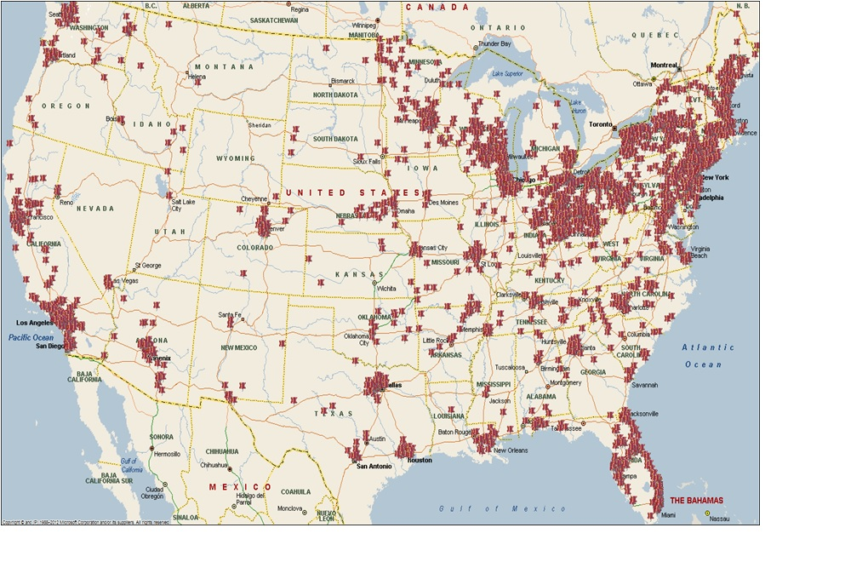
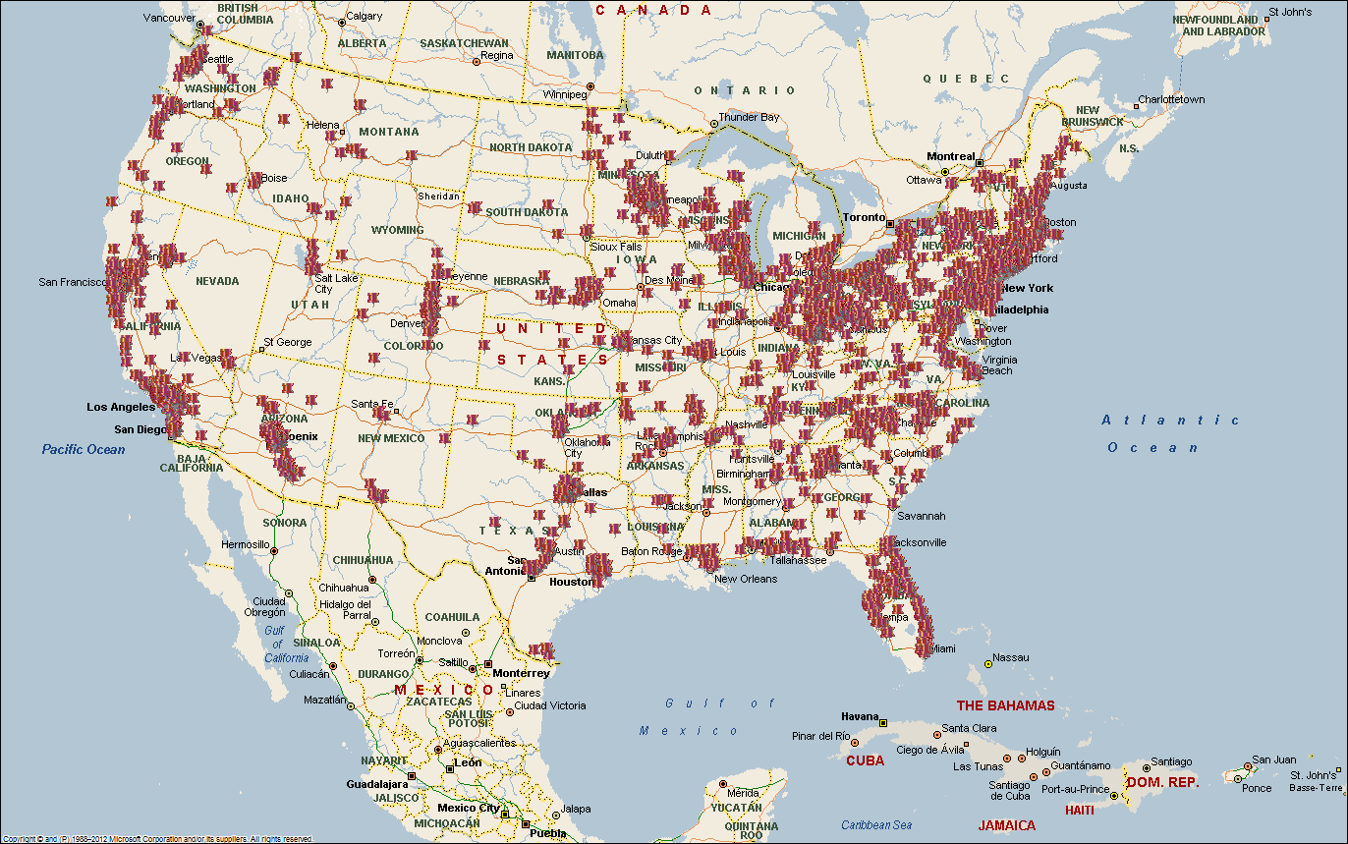
2009
2016
Notes:
We have also seen an improvement in the geographic distribution of NDTRs throughout the country, as evidenced by these maps.
The percentage of NDTRs in Arizona increased by 231% from 69 to 229, California by 79% from 382 to 684, in Texas by 44% from 118 to 170, in Tennessee by 117% from 28 to 61, in Utah by 266% from 3 to 11, in West Virginia by 81% from 11 to 20 and North Carolina by 93% from 45 to 87.
Although the Council on Future Practice 2012 Visioning Report included a recommendation to discontinue the DTR Credential, CDR has made the decision to continue to support the credential as long as it’s financially feasible to do so. The positive NDTR Registry growth statistics over the past five years support CDR’s commitment to the NDTR credential.

Slide 9
Notes:
This slide illustrates that DPD graduates are using the NDTR credential option as a step on the career ladder toward the goal of becoming an RDN. The number of NDTR’s who transition to RDN status has increased more than ten-fold since 2009 when Pathway 3 was established. In the year ending December 31, 2015 370 NDTR’s transitioned to RDN status.
CDR continues to encourage educators to promote the NDTR credential as a viable option for their graduates who wish to work in dietetics before pursuing a supervised practice program.

Slide 10
2015 Entry-Level
Dietetics Practice Audit
Notes:
In this next section of my presentation I will focus on the 2015 Entry-Level Dietetics Practice Audit and the updated test content outlines or test specifications, for the dietitian and dietetic technician examinations based on the results of the practice audit.

Slide 11
Why A Practice Audit ?
NCCA standards for Accreditation of Certification Programs.
The certification program must analyze, define, and publish performance domains and tasks related to the purpose of the credential, and the knowledge and/or skill associated with the performance domains and tasks, and use them to develop specifications for the assessment instruments. The certification program must employ assessment instruments that are delivered from the job/practice analysis…
Notes:
Why does CDR conduct a practice audit? CDR is required by its external accrediting agency, the National Commission for Certifying Agencies, or NCCA, to comply with rigorous standards for test development. One of these standards requires accredited certification programs to conduct a dietetics practice audit to empirically define practice.
The results of this rigorous research are used to update the content outlines for the entry-level registration examinations for both dietitians and dietetic technicians. This ensures that the examinations are based on actual current practice. This is distinct from educational assessment examinations which are based on what has been taught in a specific curriculum. It is the practice audit process that provides a sound legally –defensible basis for the examination content.

Slide 12
CDR 2015 Entry-Level Dietetics
Practice Audit Task Force
CLINICAL / COMMUNITY Paula Kellogg Leibovitz, MS, RD, CDE, CD-N Chair Molly Gee, MEd, RD, LD Kathryn K. Hamilton, MA, RDN, CSO, CDN, FAND Jin Kuo, MS RDN Feon Cheng, MPH, RDN Jeri Finn, MS, RD Khursheed Navder, PhD, RDN, FAND Aspen Perovich, MS, RD, LD Megan Sexton, MS, RD, LD Karen Brtko, DTR Le Greta Hudson, MS, RDN, LD, CDE Julie Mallory, MS, RD, LD | FOOD SERVICE/MANAGEMENT Kevin Sauer, PhD, RD, LD Sharon Doughten, MS, RD, LD Jennifer (Gardner) Tatro, RD Jeffery Ketcham, MBA, RD Isolda Lyon, RD Jodi Weber, DTR ACEND REPRESENTATIVE Kathleen Creedon, RD CONSULTANTS Dick Rogers Leanne Worsfold Kelly Griswold Juli Goerend
Notes:
As many of you may already be aware, CDR conducts an audit of entry-level practice every five years.
In February 2015, CDR convened a Task Force of educators, employers and entry-level practitioners charged to conduct the 2015 practice audit. In order to ensure that broad perspectives are considered in the audit process, these individuals represent diverse practice, ethnic and geographic perspectives.

Slide 13
What is a Dietetics Practice Audit?
Quantitative measure of what dietitians and dietetic technicians actually do in practice.
Comparisons of those measures with previous practice audits
Identification of distinctions between entry-level RDN and NDTR practice
Empirically validate adequacy of “entry-level” operationally defined in the past as the first three years following registration
Notes:
What is a Dietetics Practice Audit?
Quantitative measure of what dietitians and dietetic technicians actually do in practice.
Comparisons of those measures with previous practice audits
Identification of distinctions between entry-level RDN and NDTR practice
Empirically validate “entry-level” operationally defined in the past as the first three years following registration

Slide 14
Dietetics Practice Audits
Update ACEND Dietetics Education Program Accreditation Standards
Update Examination Content Outlines (Test Specifications)
Notes:
These are two primary purposes for conducting a dietetics practice audit:
ACEND uses the results of the Dietetics Practice Audit to update the ACEND Dietetics Education Program Accreditation Standards to reflect current and future practice expectations. This ensures congruence between dietetics education, credentialing and practice. Unlike the registration examination content ACEND can include future practice expectations in the educational program competencies and standards.
CDR uses the results to update the content outline, or test specifications, for entry-level dietitian and dietetic technician registration examinations to ensure that the examinations reflect current practice. This important distinction between educational testing where the examination is based on what has been taught and certification and Licensure testing which is based on practice.
With both the ACEND standards and the examination content outlines are based on current practice, the ACEND standards go beyond current practice expectations to address future practice expectations. The examinations can only address what is currently expected in practice as described in the practice audit results.

Slide 15
For each activity statement, respondents were asked to indicate:
way(s) involved: not involved / perform under supervision / perform with supervision / supervise/manage
frequency (if involved): daily / weekly / monthly / less than monthly
risk (if involved): very low / low / moderate / high / very high
Notes:
The 2015 instrument carried forward much of the questioning from the prior (2010) Audit, to preserve comparability. It included a short section of questions profiling respondent demographics, qualifications, and employment.
The majority of the instrument asked RDN practitioners to review a battery of 176 activity statements(146 for NDTRs) . For each activity statement respondents were asked to indicate;
way(s) involved: not involved / perform under supervision / perform with supervision / supervise/manage
frequency (if involved): daily / weekly / monthly / less than monthly
risk (if involved): very low / low / moderate / high / very high
For this audit, a significant change was the addition of a new section seeking to understand application of curricular knowledge areas in practice. These statements represent the foundational knowledge to perform the activities. It is important to note that these are distin
ct from knowledge statements in the ACEND competencies. Knowledge statements were developed 20 for RDNs, 19 for NDTRs. For each statement, respondents were asked to indicate:
frequency: not involved / daily / weekly / monthly / less than monthly
risk (if involved): very low / low / moderate / high / very high

Slide 16
Study Methodology
Pre-notification Postcard
Personalized invitation letter
Survey
Reminder Postcard
E-mail Reminder
Follow up Survey
Reminder Postcard
Reminder E-mail
Gift Card Incentives
Notes:
The Task Force established a very thorough study methodology that included both snail mail, e-mail communications and gift card incentives. The mailed paper survey included a link to an online survey, if the respondent was more comfortable with an online option.

Slide 17
Sampling Plan/Response Rate
RDN Sample - 3,400
(registered up to 5 years)
53% Response Rate
NDTR Sample – 2,100
(registered up to 5 years)
49% Response Rate
Notes:
53% of the 3,400 surveyed RDNs responded
and
49% of the 2100 surveyed NDTRs responded.
While this is lower than past response rates, it is still a great response considering the proliferation of online surveys.

Slide 18
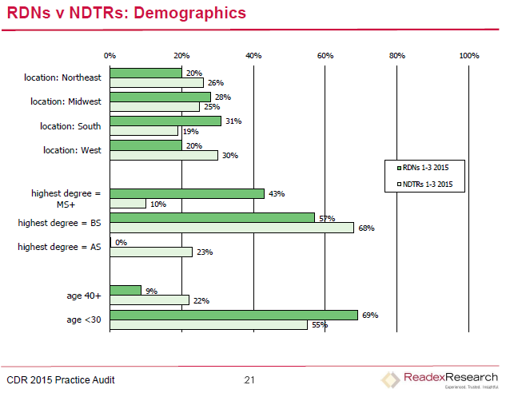
Notes:
This slide illustrates the geographic distribution of respondents versus the overall population of RDNs and NDTRs. This validates that the respondents are representative of the population as a whole.
The highest degree is also noted. For RDNs, 43% reported having a master degree or greater. For NDTR, 69% reported having a bachelors degree. This is significantly higher from previous audits due to the establishment of Pathway 3 in 2009.
NDTRs continue to be older at the entry-level, compared to RDNs, however, this percent is not as significant as it was in the past due to the influx of new DPD program graduates becoming NDTRs.

Slide 19
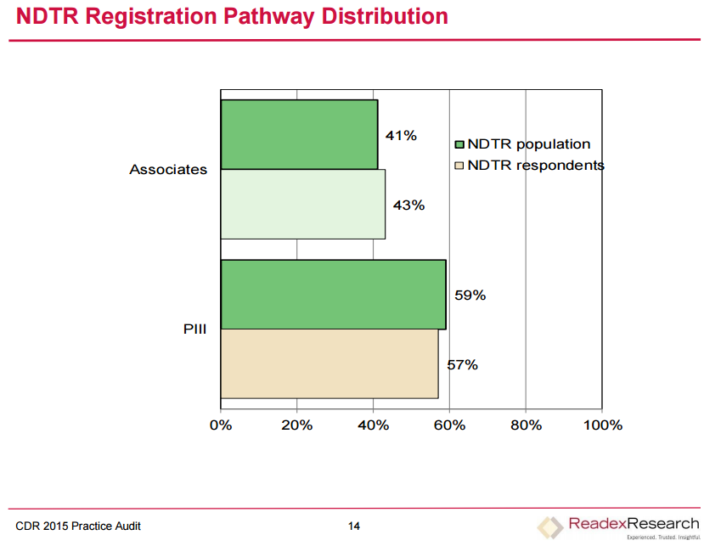
Notes:
The slide illustrates the percent of respondents by NDTR Pathway 1 or 3. For the first time Pathway 3 respondents are a larger percentage. 57% versus 43% for Pathway 1.

Slide 20
NDTRs PIII v PI : Setting(s)
Notes:
It is interesting to note that the types of positions and activities for both Pathway I and Pathway III NDTRS are comparable, with the exception of Long Term Care and rehab facilities where fewer Pathway III NDTRs are employed, 17% for Pathway III versus 27% for Pathway I.

Slide 21
NDTRs PIII v PI: Demographics
Notes:
The slide illustrates some of the demographic comparisons between Pathway I and Pathway III NDTRs. The Southern and Western regions of the country have seen the highest number of Pathway III respondents. It is interesting to note that 14% of Pathway III respondents and 6% of the Pathway I respondents report having a Masters Degree.
As in the past, the Pathway I respondents are significantly older with 49% over age 40, while only 11% of the Pathway III respondents reporting that they are over age 40. 66% of Pathway III respondents report being less than 30 years old.

Slide 22
Entry-Level
Validated as Three or Less Years in Practice
Notes:
Respondent data once again validated the current operational definition of entry-level as up to 3 years in practice as practice changes are noted beginning in year four. An article highlighting the results of the Dietetics Practice Audit will be published in the Journal of the Academy of Nutrition and Dietetics later this year.

Slide 23
Test Specification Development
Task Force - NDTR
Clinical/Community Practice | Food Service Systems Management
Paula Leibovitz, MS, RD, CDE, CDN, Chair | Margaret Garfoot, MS, RD
Karen Brtko, DTR | Isolda Lyon, RD, LDN
Molly Gee, MEd, RD, LD | Victoria Rethmeier, MS, RD, CDE, LMNT
Joann Gruner, MBA, RD, LD | Kevin Sauer, PhD, RD, LD
Christine Hartney, MS, RD, CNSC | Jodi Weber, DTR
Kathryn Hardison, MS, RD
Coleen Liscano, MS, RDN, CSP, CDN, CNSC, IBCLC | CDR/Pearson VUE
Khursheed Navder, PhD, RD, FAND | Kay Manger Hague, RD – CDR
Aspen Perovich, MS, RD | Julie Miles, - Pearson VUE
Becky Sulik, RDN, CDE, LD | Xinrui Wang – Pearson VUE
Holly Trueblood, DTR | Juli Goerend – Pearson VUE
Notes:
The practice audit respondent data regarding frequency of involvement and risk for each activity and knowledge statement was then used by two subject matter expert task forces to update the registration examination content outlines. These next two slides list the names of each Task Force.
Once again, each Task Force was selected to include representation from diverse ethnic, geographic and practice perspectives including educators, employers and entry-level practitioners.

Slide 24
Test Specification Development
Task Force - RDN
Clinical/Community Practice | Foodservice Systems Management
Paula Leibovitz, MS, RD, CDE, CDN, Chair | Kathryn Lawson, MS, RDN, CD
Feon Cheng, MPH, RDN | Jeffrey Ketcham, MBA, RD
Robin Evans, MPH, RD | Mary Beth Ohlms, MEd, RD, LDN
Molly Gee, MEd, RD, LD | Kevin Sauer, PhD, RD, LD
Laura Romig Gollins, MBA, RD
Kathryn Hardison, MS, RD | CDR/Pearson VUE
Kathryn Hamilton, MA, RD | Kay Manger Hague, RD – CDR
Young Hee Kim, MS, RD, LDN, CNSC | Julie Miles, - Pearson VUE
Rachel Kossover, MPH, RDN | Xinrui Wang – Pearson VUE
Coleen Liscano, MS, RDN, CSP, CDN, CNSC, IBCLC | Juli Goerend – Pearson VUE
Khursheed Navder, PhD, RD, FAND
Aspen Perovich, MS, RD
Bruce Rengers, PhD, RD
Becky Sulik, RDN, CDE, LD
Pauline Williams, PhD, MPA, RDN, CD

Slide 25
Translating the Practice Audit Results into Test Specifications
Involvement
Frequency
Risk
Notes:
As I mentioned earlier, the audit respondents replied to activity rating scales for each activity statement; involvement, frequency and risk. This was the first test specification meeting with CDR’s new testing vendor ,Pearson VUE. Like ACT, Pearson VUE also used only the frequency and risk ratings for the test specification update process. These 2 scales are combined into a single rating scale using a ranking method. Since the purpose of certification is to protect the public this ensures that the test content addresses the critical knowledge or skills areas necessary for safe and effective practice.
This also means that risk is given greater emphasis when combining the two scales. There are some activities that may be high risk but are performed very infrequently, annual budget preparation would be an example of this type of activity.
Working independently under the direction of the Pearson VUE psychometrician, the Task Force members, for each examination, independently mapped each of the practice audit knowledge and activity statements to the current content outlines. The Task Force then reconvened as a group to reach consensus on the mapping exercise using a 2/3 majority agreement as the standard for consensus for each statement.

Slide 26
NDTR Test Specifications
2012
2017
I. | Food and Nutrition Sciences | 10%
 | A. Principles of Food Preparation
 | B. Food Composition
 | C. Principles of Basic and Normal Nutrition
II. | Nutrition Care for Individuals and Groups | 34%
 | A. Screening and Assessment
 | B. Diagnosis
 | C. Planning and Intervention
 | D. Monitoring and Evaluation
III. | Principles of Education and Training | 7%
 | A. Assessment and Planning
 | B. Implementation and Evaluation
IV. | Foodservice Systems | 22%
 | A. Menu Development
 | B. Procurement and Supply Management
 | C. Food Production, Distribution, and Service
 | D. Sanitation, Safety, and Equipment
V. | Management of Food and Nutrition Services | 27%
 | A. Human Resources
 | B. Finance and Materials
 | C. Marketing Products and Services
 | D. Management Principles and Functions
 | E. Quality Processes and Research
I. | Nutrition Science and Care for Individuals and Groups | 44%
 | A. Principles of Basic and Normal Nutrition B. Screening and Assessment
 | C.. Planning and Intervention
 | D Monitoring and Evaluation
II. | Food Science and Food Service | 24%
 | A. Menu Development
 | B. Procurement and Supply Management
 | C. Food Production, Distribution, and Service
 | D. Sanitation, Safety, Facility and Equipment
III. | Management of Food and Nutrition Services | 32%
 | A. Human Resources
 | B. Finance and Materials
 | C. Marketing Products and Services
 | D. Management Principles and Functions
 | E. Quality Processes and Research
Notes:
This slide reflects the current NDTR test specifications side-by-side with the new specifications. It is important to note that there were no new content areas identified for the NDTR Test Specifications. As the very first step in the update of these test specifications the Task Force merged current Domain III Principles of Education and Training into Domain I Nutrition Science and Care for Individuals and Groups. When you see the updated study outline you will see that the majority of this content area is subsumed in Domain I Topic B Planning and Intervention. The current Domain II Topic B Diagnosis was removed since this is not included in the scope of practice for NDTRs. The audit results supported that NDTRs do not perform these activities. You will also note that current Domains I and II on the current outline were merged. The total percentage for the original three domains was 51%. The new domain I is 44%. The topics related to food preparation and composition shifted from the former Domain I to the new domains II & III, II – Food Science and Food Service; and III – Management of Food and Nutrition Services. You will also note that Foodservice Systems and Management of Food and Nutrition Services is 56% of the new test specifications versus 49% in the current specifications. This is reflective of the management roles held by entry-level NDTRs. A link to the expanded study outline is included in your handout materials. This outline will provide you with detail regarding the specific topic areas addressed in each content domain.

Slide 27
RDN Test Specifications
2012
2017
I. | Principles of Dietetics | 12%
 | A. Food Science and Nutrient Composition of Foods
 | B. Nutrition and Supporting Sciences
 | C. Education and Communication
 | D. Research
 | E. Management Concepts
II. | Nutrition Care for Individuals and Groups | 50%
 | A. Screening and Assessment
 | B. Diagnosis
 | C. Planning and Intervention
 | D. Monitoring and Evaluation
III. | Management of Food and Nutrition Programs and Services | 21%
 | A. Functions of Management
 | B. Human Resources
 | C. Financial Management
 | D. Marketing and Public Relations
 | E. Quality Improvement
IV. | Foodservice Systems | 17%
 | A. Menu Development
 | B. Procurement, Production, Distribution, and Service
 | C. Sanitation and Safety
 | D. Equipment and Facility Planning
 | E. Sustainability
I. | Principles of Dietetics | 25%
 | A. Food Science and Nutrient Composition of Foods
 | B. Nutrition and Supporting Sciences
 | C. Education, Communication and Technology
 | D. Research Applications
II. | Nutrition Care for Individuals and Groups | 40%
 | A. Screening and Assessment
 | B. Diagnosis
 | C. Planning and Intervention
 | D. Monitoring and Evaluation
III. | Management of Food and Nutrition Programs and Services | 21%
 | A. Functions of Management
 | B. Human Resources
 | C. Financial Management
 | D. Marketing and Public Relations
 | E. Quality Management and Improvement
IV. | Foodservice Systems | 14%
 | A. Menu Development
 | B. Procurement, Production, Distribution, and Service
 | C. Sanitation and Safety
 | D. Equipment and Facility Planning
Notes:
This slide reflects the current RDN test specifications side by side with the new specifications effective January 1, 2017.
As with the NDTR content outline, there were no new content areas identified Domain I was expanded to include foundational knowledge areas that were subsumed in the current test specifications under Domains II and III and IV.
As a result, Domain I increased from 12% to 25% and Domain II decreased from 50% to 40%. Domains I and II combined increased from 62% to 65% of the examination. Domains III and IV, Management of Nutrition Programs and Services and Foodservice Systems decreased from 38% to 35%. Sustainability was subsumed in Domain IV B . The new outline reflects the fact that management crosses all areas of dietetics practice including clinical, community, not just foodservice systems management.
Again, a link to the expanded study outline is included in your handout materials. This outline will provide you with detail regarding the specific topic areas addressed in each content domain.
A webinar highlighting the 2015 Dietetics Practice Audit and the updated test specifications is available on both the NDEP portal and the CDR Website program director page. Please share this information with your faculty colleagues who are unable to attend an NDEP Area Meeting.
The Study Guides are being updated to reflect the new test specifications. It is anticipated that the new study guides will be available September 2016 for use by exam candidates who will be taking the registration exams beginning January 2017.

Slide 28
Registration Eligibility Processing System (REPS)
Streamlined Process
Notes:
Another new CDR initiative of interest to educators, is the Registration Eligibility Processing System, or REPS. This new streamlined system is intended to replace the Credentialed Registration Maintenance System (CRMS) online registration eligibility processing system. Several educators participated in the pilot-test of this new process earlier this year. Their input was valuable in refining the process.

Slide 29

REPS Goals
Respond to program director consensus regarding CRMS efficiencies.
Improve the application experience for program directors
Enhance student processing accuracy and efficiency
Improve reporting capabilities
Provide for CDR primary source verification of degree completion
Notes:
The goals of this programing update were to:
Respond to program director concerns regarding CRMS efficiencies.
Improve the application experience for program directors
Enhance student processing accuracy and efficiency
Improve reporting capabilities
Provide for CDR primary source verification of degree completion
Thank you to everyone who assisted CDR by participating in the program pilot test and evaluation of the new system which was implemented on March 1, 2016.

Slide 30
Practice Competency-based Professional Development Initiative
Notes:
Another new initiative that CDR began in late 2012 is the Practice Competencies Initiative. CDR’s Competency Assurance Panel is collaborating with the Academy’s Quality Management Committee on the development of dietetics practice competencies to support the Professional Development Portfolio recertification system. It is important to note that these are practice competencies distinct from the education program competencies you are familiar with for dietetics education programs.
These competencies and performance indicators will replace the current learning need codes in the Professional Development Portfolio recertification system.
The Competency Assurance Panel and Quality Management Committee have worked with over one hundred dietetics practitioners from across the country to draft, review and edit the competencies. Many practitioners have reported that the new competencies will serve a dual purpose in the employment setting where employers are developing competency-based performance management systems. A national validation study was conducted in Spring 2014 to validate the practice competencies. An article describing the validation study methodology and results was published in the June 2015 Academy Journal.

Slide 31

Educator Tool - Kit
Goal Wizard tutorial
Dream Wizard demonstration
YouTube video
Lesson plan
Recorded presentations
FAQ
Key messages
Notes:
CDR has developed an educator toolkit to assist educators in introducing their students to the new competencies based PDP recertification system.
The toolkits include
Goal Wizard tutorial
Dream Wizard demonstration
YouTube video
Lesson plan
Recorded presentations
FAQ
Key messages
The toolkit is available on both the NDEP portal and CDR’s website. The April 20th student webinar was recorded and will be available on both CDR website and NDEP portal. Your handouts include a comprehensive list of resources.

Slide 32
Graduate Degree for
Entry-Level Eligibility
Effective January 1, 2024
Notes:
I know that most of you are aware of the new graduate degree registration eligibility requirement, but I though I would take a few minutes to explain to you how CDR’s action to change the entry-level registration eligibility degree requirements to the minimum of a graduate degree effective January 1, 2024, is both responsive to the Council’s Visioning Report recommendation and sensitive to the needs of ACEND for new standards development. It is important to note that this deadline does not impact the timeline for ACEND standards development and program adoption of the new ACEND standards, which may extend beyond 2024. It is likely that CDR will establish another deadline in the future addressing an ACEND accredited graduate degree program.
CDR as the administratively autonomous credentialing agency for the Academy is charged in the Bylaws with the establishment of registration eligibility requirements for its certification programs.

Slide 33
CFP Visioning Report
CFP Recommendation #1
Elevate the preparation for the future entry-level RDN to a minimum of a Graduate degree from an ACEND-accredited program.
CDR Motion – April 2013
Move to change the entry-level registration eligibility education requirements for dietitians beginning in 2024 from a baccalaureate degree to a minimum of a graduate degree. All other entry-level dietitian registration eligibility requirements remain the same.
CDR’s Motion does NOT require that the graduate degree be granted by an ACEND accredited program.
Notes:
At its April 2013 meeting, CDR made the motion noted on this slide to change the entry-level registration eligibility education requirements for dietitians beginning in 2024 from a baccalaureate degree to a minimum of a graduate degree. All other entry-level dietitian registration eligibility requirements remain the same. It is important to note that just as the current baccalaureate degree may be in any area, the graduate degree may also be in any area, provided the applicant has also completed the ACEND accredited DPD and supervised practice programs.
CDR reaffirmed this motion at its April 2015 meeting.

Slide 34
Eligibility Criteria for RDN
Current
2024
Baccalaureate degree from a US accredited college or university or foreign equivalent
ACEND-accredited DPD program
ACEND-accredited supervised practice (coordinated program, dietetic internship, or ISPP)
Graduate degree from a US accredited college or university or foreign equivalent
ACEND-accredited DPD program
ACEND-accredited supervised practice (coordinated program, dietetic internship, or ISPP)
Notes:
As this slide illustrates, all other requirements for registration eligibility remain the same; applicants will still need to complete an ACEND accredited Didactic Program in Dietetics and an ACEND accredited supervised practice program. Instead of a baccalaureate degree they must have completed the minimum of a graduate degree. The graduate degree may be in any area. Your handout include a link to a Fact Sheet addressing frequently asked questions regarding the graduate degree requirements is also included in your handout for this session and a link to student options for meeting the new degree requirement using ACEND accredited existing programs.

Slide 35
Graduate Degree Registration Eligibility
Requirement
Effective January 1, 2024
This Date Does Not Impact
The ACEND Standards
Development Process
Notes:
As you have heard from ACEND, they are in the process of developing new standards right now.
Once these standards have been implemented and ACEND establishes a deadline for adoption, CDR will also revise its registration eligibility requirements to reflect the new standards.
It is likely that there will be another registration eligibility deadline following implementation of the new ACEND standards.

Slide 36
Eligibility Criteria Exception
Current RDNs
Not Required
to Obtain
Graduate Degree
Notes:
At this time, I would like to underscore that all current RDNs, who do not have a graduate degree, will not have to obtain one in order to remain registered. However, if a current RDN allows their credential to expire for failure to meet CPEU requirements or to submit their registration maintenance fees, the practitioner will have to meet new eligibility requirements if he/she chooses to re-establish their credential.

Slide 37
Registration Examination
Content Outline
The Content Outline Will
Change Over Time Based on
Dietetics Practice Audit Results
Notes:
It is also important to note, that the content of the registration examination for dietitians will only change based on the results of the practice audits.
CDR conducts practice audits every five years. CDR is currently conducting the 2015 entry-level practice audit, audits will continue at five year intervals thereafter.
The exam is not based on the dietetics education program or degree requirements; it is based on current entry-level practice.

Slide 38
Next Steps
On-going communications to stakeholders
Review and update of registration eligibility systems and information
Notes:
Our Next Steps will be on-going communications to stakeholders and the
review and update of registration eligibility systems and information.

Slide 39
CDR Scholarships/Fellowships
Over One Million Dollars in CDR Scholarships Awarded Since 2011
Annually
10 -$10,000 Doctoral Scholarships
20 - $5,000 Diversity Scholarships
4 - $10,000 PhD to RD Fellowships

Slide 40
CDR Website Resources
Preceptor Online Training Course
Coming soon….
Assessing Prior Learning Online Course
Notes:
In closing, I would just like to note that your handouts include information on several CDR resources of special interest to educators.
The slide highlights the CDR Preceptor Training online course and coming this spring a new online prior learning assessment course to assist you with non-traditional student evaluation.

Slide 41

QUESTIONS

